Slide 1

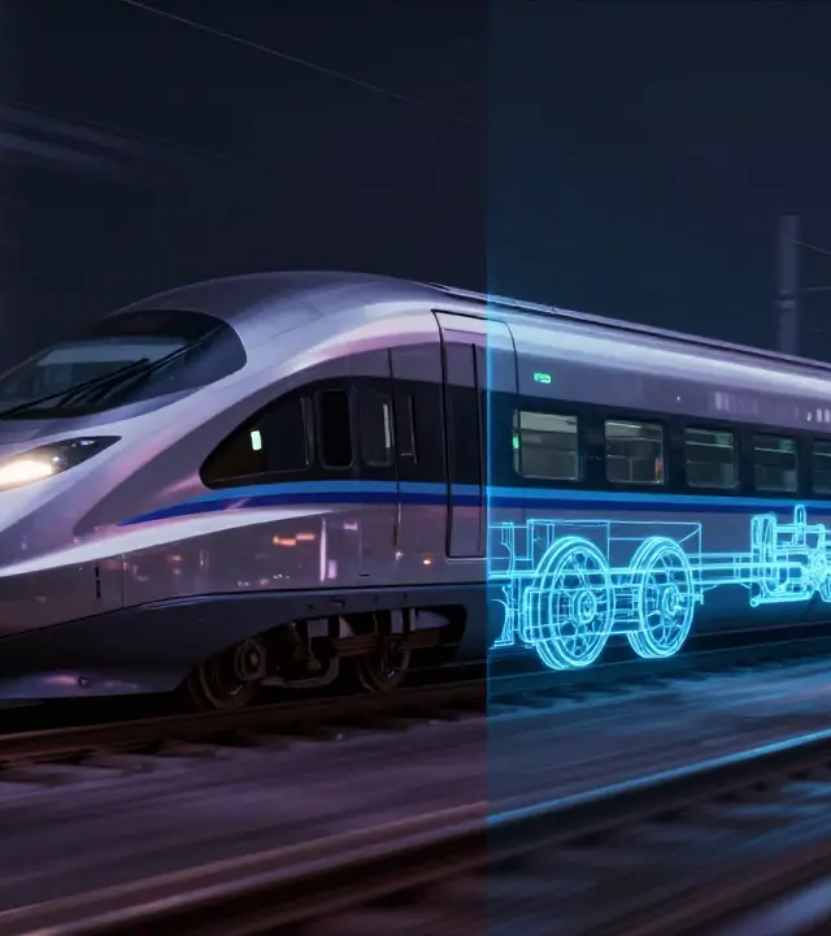


System Active
Seeing the Unseen at
80 km/h
The first Edge-AI platform for real-time structural intelligence in High-Speed Rail
Edge Computing | Motion Deblurring | Structural Intelligence
RAILVISION AI

Slide 2



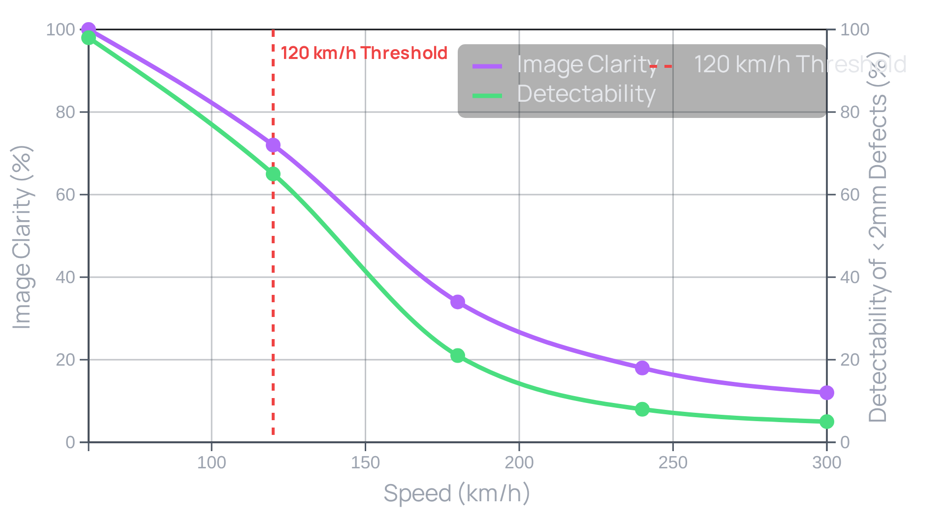





System Active
The High-Speed Challenge
Image Clarity vs. Velocity
Motion Blur Gap Analysis
Image clarity drops below 30% at 100 km/h
Detectability of micro-fractures plummets beyond 120 km/h
Image quality drops by over 65% between 120 km/h and 200 km/h
Creates a critical blind spot in traditional inspection regimes
"At speeds exceeding 120 km/h, conventional optical sensors suffer severe image degradation due to motion blur, masking micro-fractures and structural anomalies that could lead to derailments."

Slide 3






















System Active
The Solution - Edge AI Architecture
Edge AI Architecture
Zero-Latency Processing
NVIDIA Jetson Orin modules optimized with TensorRT for maximum inference efficiency
Multi-Spectrum Cameras
NVIDIA Jetson Orin
Immediate Alerting
Inference times under 0.02ms per frame, enabling real-time processing at 120 FPS
120 FPS capture of visible and infrared data
On-device AI inference with TensorRT optimization
Critical defects flagged within 1.2 seconds
Decentralized approach ensures real-time decision-making without dependency on remote servers
Performance:
Only alerts and metadata transmitted to the cloud, not raw images
< 0.02ms
120 FPS
99.9%
Per Frame
Processing
Accuracy
Immediate response to structural anomalies without network latency
Cloud Analytics
Train Integration
Long-term analytics and fleet management
Seamless operation on high-speed rail systems
"RailVision AI overcomes the latency and bandwidth limitations of cloud-based processing by deploying a zero-latency edge computing architecture."

Slide 4































System Active
Technical Core - GAN Engine
Before-After Comparison
Motion Deblurring GANs
Reconstructs fine structural details from blurred input frames
Enables detection of micro-fractures and surface anomalies below 2mm
Before: Motion-Blurred
After: GAN-Reconstructed
Operates with sub-millimeter precision to restore critical structural features
Validated at speeds up to 300 km/h with 99.9% accuracy
"The GAN-based deblurring algorithm restores sharp textures and structural features that are invisible to traditional imaging systems, enabling detection of defects that would otherwise remain hidden."
Motion blur effect
Fine details restored
Micro-fracture detection
Structural feature restoration

Slide 5

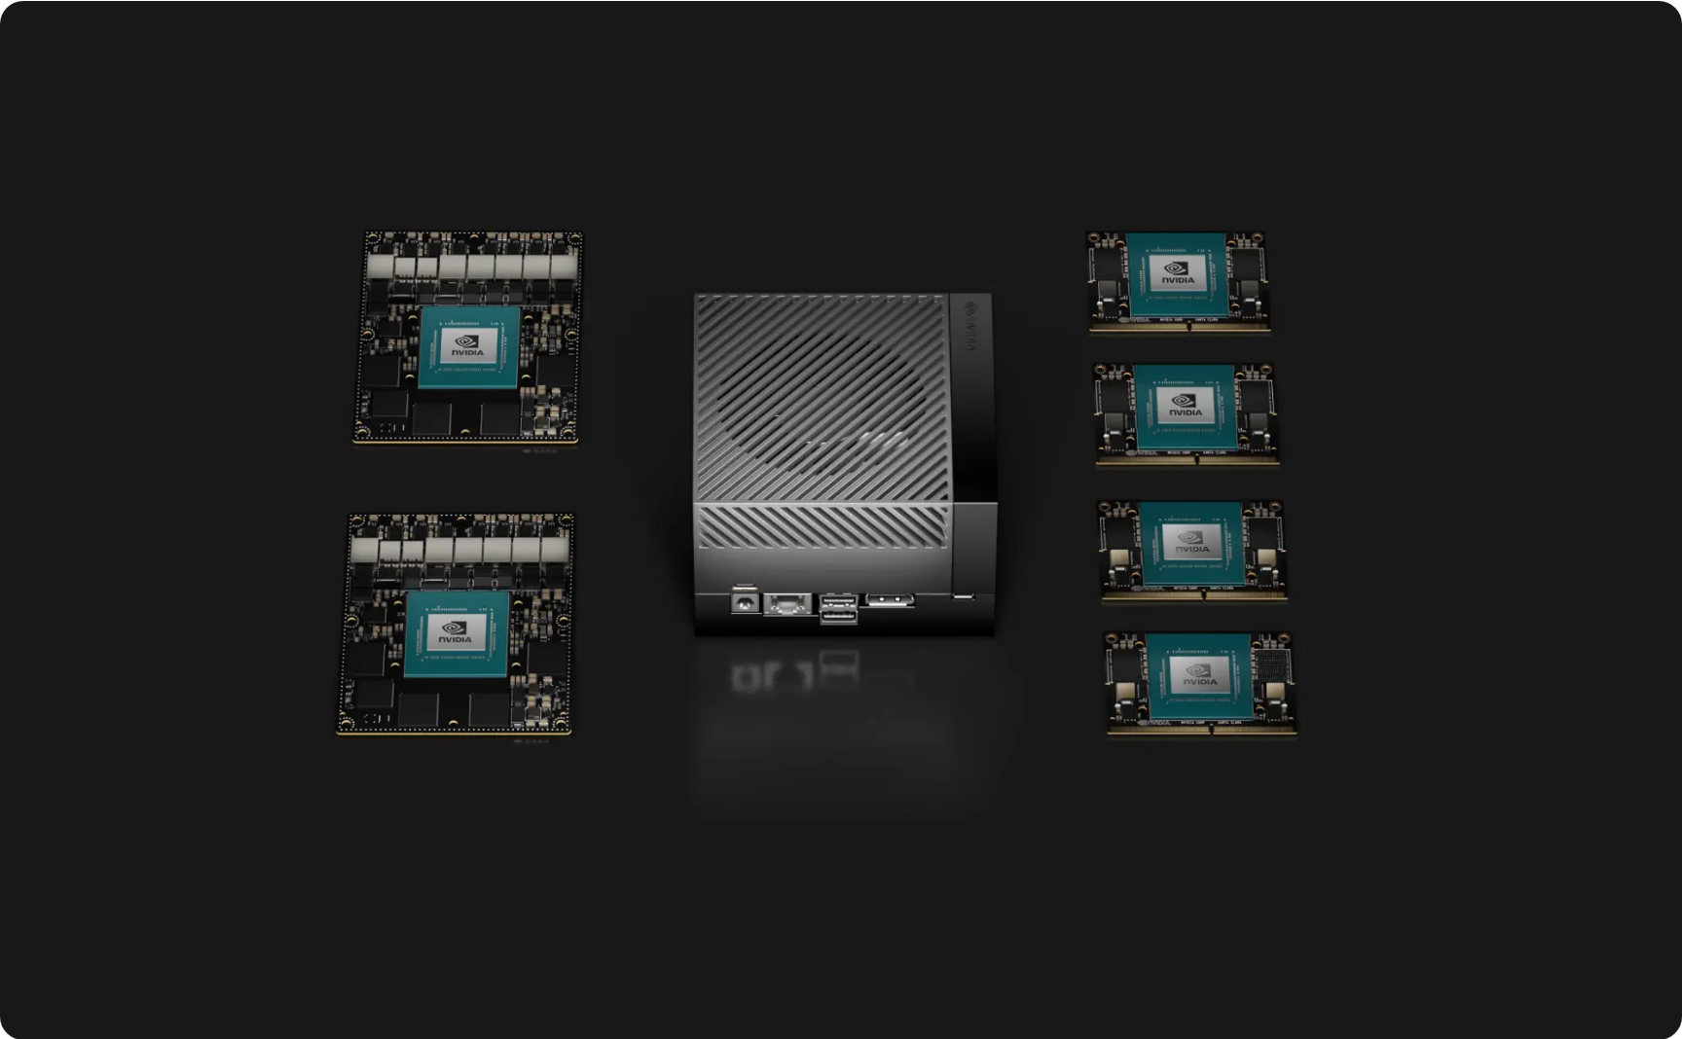











System Active
Hardware Synergy
Military-Grade Hardware Stack
120 FPS Multi-Spectrum Cameras
Capturing visible and infrared data simultaneously for all-weather operation
NVIDIA Jetson Orin Compute
Optimized with TensorRT for zero-latency processing at 120 FPS
IP67-Rated Rugged Housing
Protection against dust, water, and mechanical shock in harsh rail environments
NVIDIA Jetson Orin Compute Module & Components
Railway Standards Compliance
CAN Bus Interface
EN 50155
EN 45545-2
Rail Industry Standards
Synchronization with train velocity sensors for perfect frame consistency

Slide 6










System Active
Performance Metrics
Defect Detection Accuracy
Operational Reliability
Inference Speed
< 0.02
80%
24/7
ms
Sustained accuracy across 10,000+ test images
All-condition operation
Per frame processing time
Meets EN 50155 and EN 45545-2 standards
Real-time processing at 120 FPS
Minimal false positives
NVIDIA Jetson Orin NX hardware
TensorRT optimization
Modular architecture

Slide 7















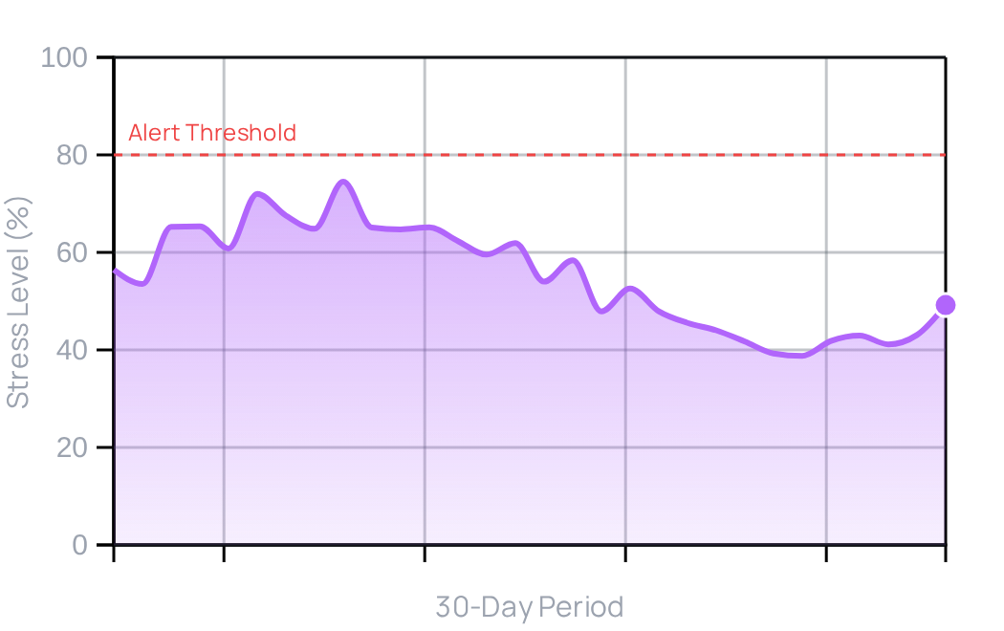





















System Active
The Dashboard - Analytics in Action
Live Defect Alerts
Updated: Just now
30-Day Trend Analysis
System Performance
1
Critical: Axle crack detected
Axle Stress Accumulation
Live Alert Processing
Geospatial Accuracy
3
Major: Fastener loosening
0.1
sec
±1.5
meters
5
Minor: Surface rust
Data Refresh Rate
Concurrent Users
Geospatial Map Overlay
2
Hz
500
max
Role-Based Access
Critical
Field Tech
Maintenance
Operations
Major
Minor
Rolling 30-day window for predictive analytics
Auto-generates maintenance work orders

Slide 8



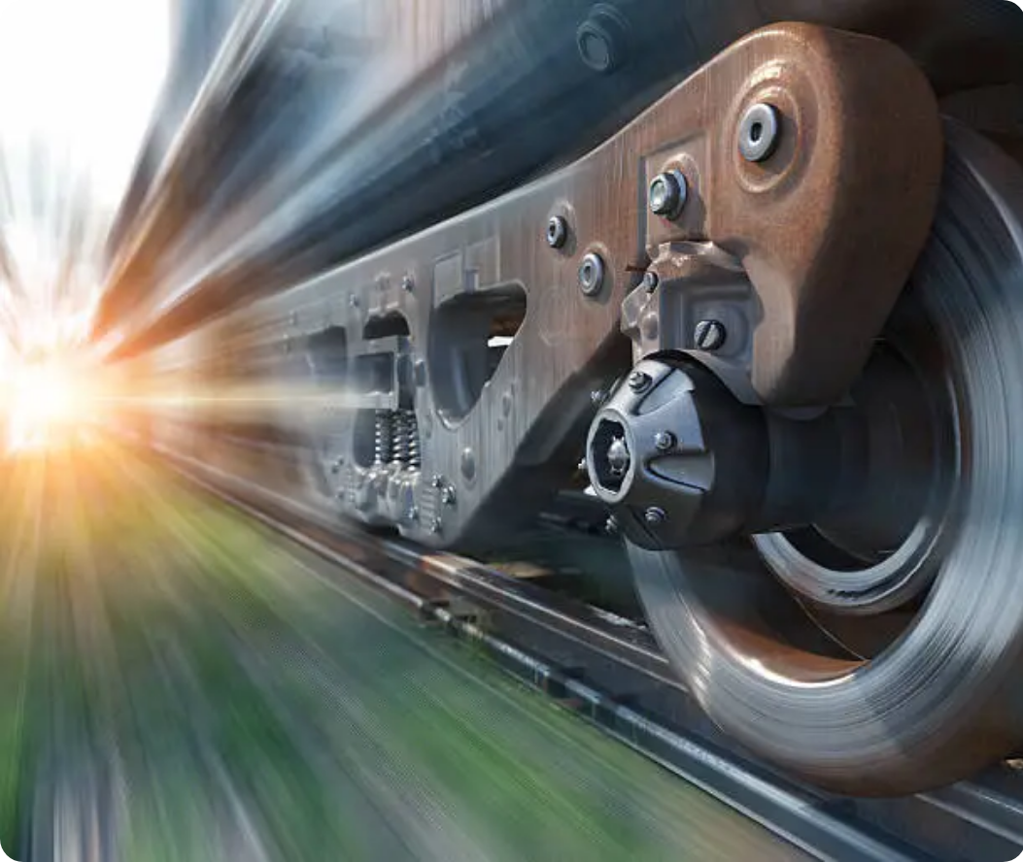















System Active
Case Studies - Defect Detection
Axle Micro-Fracture Detection
Critical
1.8mm micro-fracture detected at 280 km/h on high-speed train.
Speed: 280 km/h
Detection Time: 1.2s
Status: Prevented Derailment
Wheel Flat Spot Identification
Major
Flat spot detected at 250 km/h on freight train in European network.
Speed: 250 km/h
Location: Europe
Status: Scheduled Maintenance
Surface Corrosion Monitoring
Minor
Early-stage rust detected on rail joint in coastal region with high humidity.
Environment: Coastal
Response: 48h
Status: Preventive Action
Real-World Detection
RailVision AI's GAN-based deblurring engine enables detection of critical defects that would be invisible to traditional imaging systems at high speeds.

Slide 9
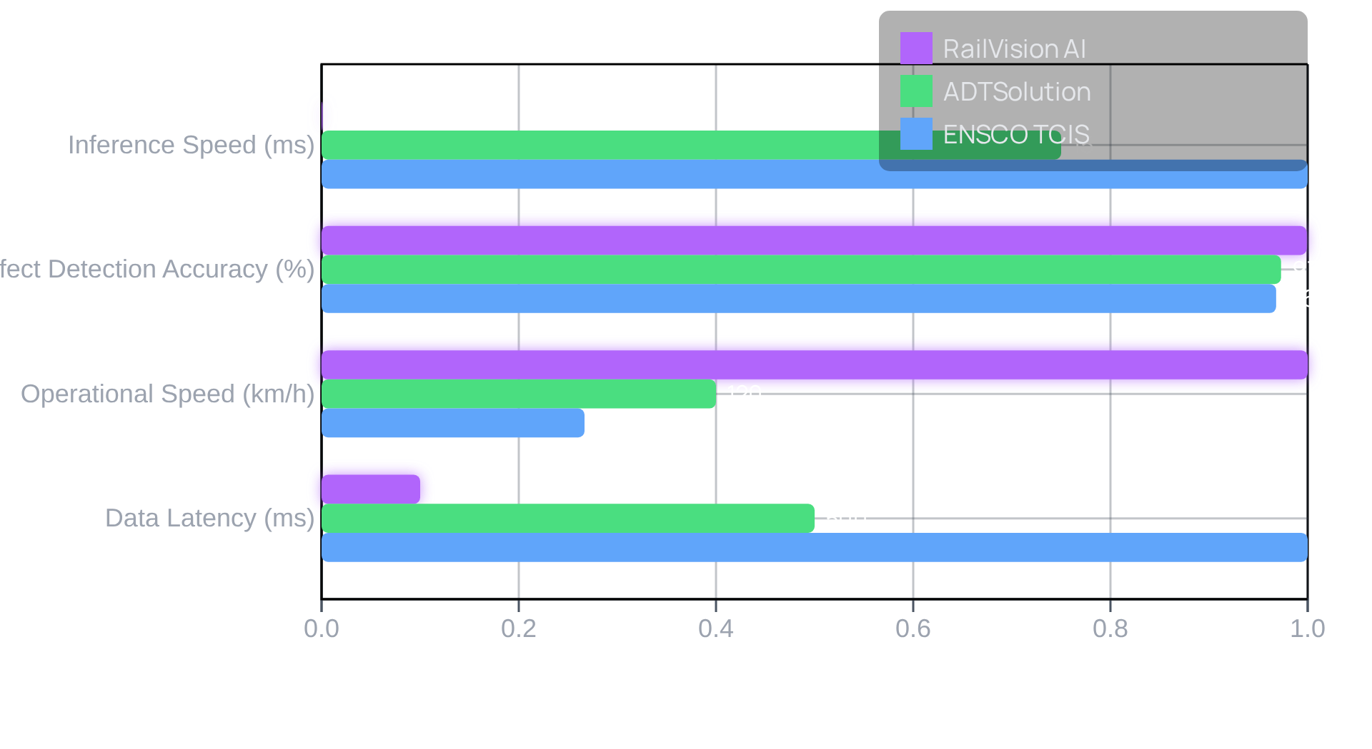




System Active
Comparative Performance Analysis
Performance Metrics Comparison
Benchmark Comparison
RailVision AI achieves sub-0.02ms inference time vs. 15ms for ADTSolution and 20ms for ENSCO TCIS
99.9% defect detection accuracy vs. 97.3% for ADTSolution and 96.8% for ENSCO TCIS
Operational capability at 300 km/h vs. 120 km/h for ADTSolution and 80 km/h for ENSCO TCIS
Real-time processing with <100ms data latency vs. 500ms for ADTSolution and 1s for ENSCO TCIS
"The combination of ultra-low latency and near-perfect accuracy positions RailVision AI as a transformative solution for high-speed rail safety, enabling predictive maintenance at scale while minimizing operational disruption."

Slide 10











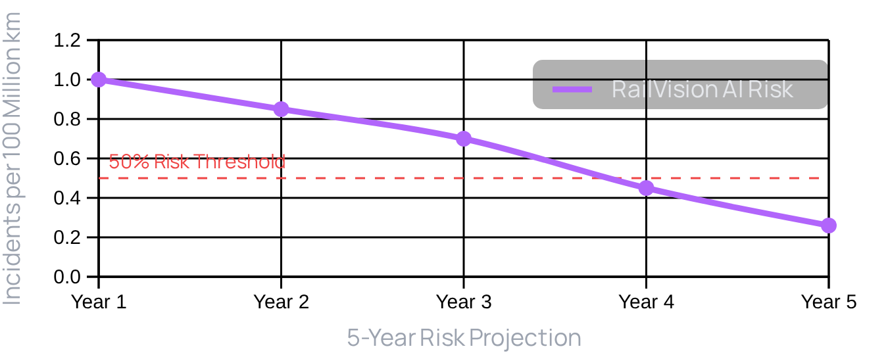
System Active
Safety Impact Assessment
78%
Quantifying the Safety Benefits
Risk Reduction
78% reduction in derailment risk over a five-year period
Early detection of structural weaknesses prevents failures before they occur
Baseline Risk
With RailVision AI
Protection of passengers, crew, and infrastructure from catastrophic failures
1.2 incidents
0.26 incidents
per 100 million km
per 100 million km
Shift from reactive to predictive maintenance approach
"Simulation models based on historical rail accident data and defect propagation rates indicate that RailVision AI can reduce derailment risk by 78% over a five-year period."

Slide 11
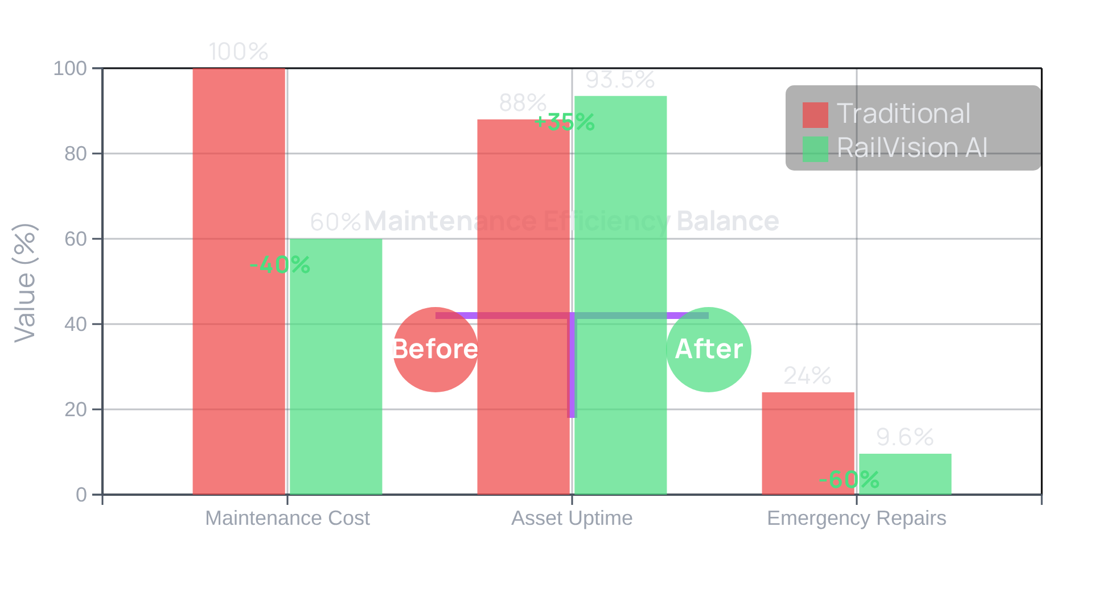







System Active
ROI & Cost Efficiency
Transforming Maintenance Economics
Maintenance Optimization
40% Reduction
in annual maintenance costs
35% Increase
in asset uptime
60% Decrease
in emergency repair interventions
"The shift to condition-based maintenance enabled by RailVision AI results in substantial cost savings while improving operational efficiency."

Slide 12











System Active
Technical Specifications
Hardware Requirements
IP67 Ruggedization
Railway Standards Compliance
Protection against dust and water ingress
EN 50155 railway electronic equipment standards
Shock-absorbing mounts for vibration mitigation
EN 45545-2 fire protection certification
Tested to withstand vibration levels up to 20g
Military-grade reliability for harsh environments
Thermal Management
Mechanical Interface
Active cooling system for continuous operation
Modular design for easy maintenance
Prevents overheating during prolonged use
CAN bus interface for train velocity synchronization
Wide operating temperature range
Field-replaceable components for long-term reliability
All components designed for 24/7 operation in high-speed rail environments

Slide 13























System Active
Multi-Spectrum Imaging Capabilities
Dual-Spectrum Technology
60 FPS Multi-Spectrum Cameras
Visible Light
Infrared
Simultaneous visible and infrared light capture
Perfect Synchronization
Synced with train velocity sensors
High Frame Rate
Real-time processing at 80 km/h
Operational Environments
Low-Light
Adverse Weather
Environmental Performance
Tunnels and nighttime operations
Rain, snow, fog penetration
Clear visibility in tunnels and nighttime operations
Reliable operation during rain, snow, and fog
Temperature Analysis
High-Speed Operation
Heat signature detection
Performance at 80 km/h

Slide 14
















System Active
Fleet Management Integration
RailVision AI
Fleet Management
Maintenance Team
Edge-AI Platform
Work Order System
Field Operations
Automated Work Orders
Maintenance Scheduling
Role-Based Access
Auto-generates maintenance work orders based on predefined thresholds, reducing administrative overhead and ensuring timely interventions.
Optimizes maintenance schedules by prioritizing defects based on severity and proximity to critical thresholds.
Supports multi-user access with tailored views based on user roles, ensuring relevant data visibility for field technicians and managers.
Key Advantage: The integration enables a shift from scheduled to condition-based maintenance, optimizing resource allocation and minimizing operational disruption.

Slide 15
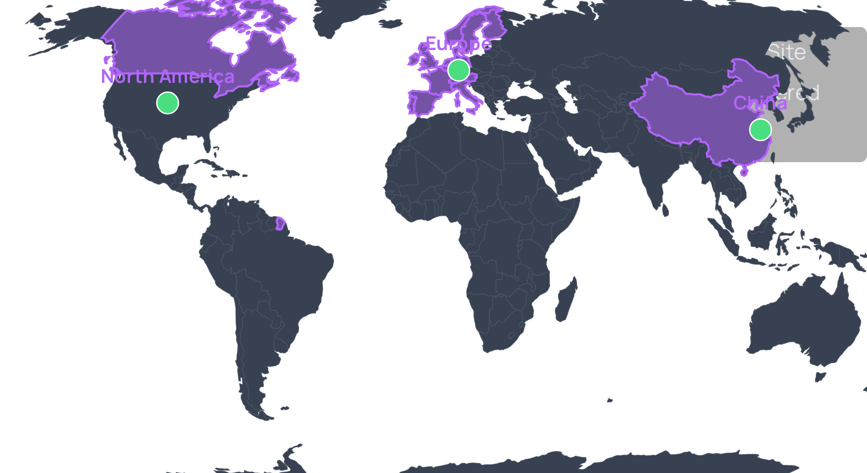




System Active
Global Deployment Readiness
Global Validation Coverage
Universal Applicability & Reliability
Validated performance across European, Chinese, and North American rail networks
Field tests on Beijing-Shanghai High-Speed Railway confirmed system reliability under operational conditions
Benchmarked against industry standards including ADTSolution and ENSCO's Track Component Imaging System
Meets stringent EN 50155 (railway electronic equipment) and EN 45545-2 (fire protection) standards
"The system has been rigorously tested across diverse rail networks, validating its robustness under real-world conditions."

Slide 16















System Active
Future Roadmap
Technology Evolution Pathway
2026
2027
2028
2029
Enhanced AI Models
Expanded Defect Categories
Autonomous Systems Integration
Global Standards & Ecosystem
Sub-millimeter precision at 90+ km/h
Real-time structural fatigue assessment
Self-guided inspection vehicles
International railway safety integration
Adaptive learning from inspection data
Predictive maintenance automation
Early-stage corrosion detection
Swarm intelligence for network-wide inspection
Open API for third-party systems
Multi-spectrum fusion capabilities
Material degradation analysis
Global fleet health monitoring platform
Our Vision: Create a railway safety ecosystem where structural integrity is maintained proactively through AI-driven insights, enabling safe speeds of 350+ km/h while reducing maintenance costs by 45%.

Slide 17

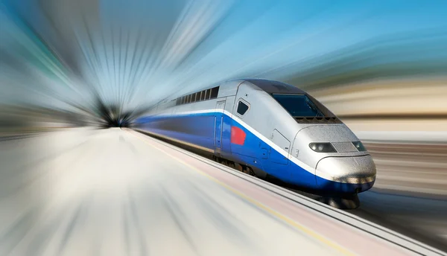




AI1 – Bit Benders
Redefining Railway Safety
Ready for the Pilot Deployment?
GitHub Repository
Join us in transforming high-speed rail safety with the first Edge-AI platform capable of real-time structural intelligence at 90 km/h.
Varad Vekariya
Scan to Access
Team Leader
Live Technical Demo
Kunj Shah
Backend Dev
Pilot Deployment Benefits
Girishan B
Frontend Dev
78% reduction in derailment risk
Kuldeep Thakkar & Dhruv Patel
40% reduction in maintenance costs
Testing & Researching
35% increase in asset uptime

